Slide 1
Wooble challenge submission
IPL Crunch 26
A data-first analysis of toss impact, match phases, all-time performers, and one finding that challenges fan intuition.
Julius analysis pack
01

Slide 2
Question one
Does winning the toss actually matter?
• Toss winners also won the match in 51.62 percent of completed games.
• That is only a marginal edge, not a dominant predictor.
• The toss influences conditions, but execution still explains most match outcomes.
• This is a strong myth-busting insight for the judges because it pushes beyond fan opinion.
Small edge, not destiny
02

Slide 3
03
Question two
Which innings phase shapes victory the most?
Death overs
Strongest relationship with winning. Finishing power and late control separate winners most clearly.
Middle overs
Second most important. This phase often decides whether a team builds momentum or leaks control.
Powerplay
Still matters, but less than the later stages when win probability swings faster.
Death overs lead
03

Slide 4
04
Question three
Who stands out across seasons?
Top batter
Virat Kohli leads the full dataset with 9,155 runs.
Top bowler
Yuzvendra Chahal leads with 238 wickets.
Elite consistency
High-volume performers keep appearing because longevity and repeatability matter as much as peaks.
Team strength
Among long-running teams, Chennai and Mumbai stay near the top, while newer franchises can spike early.
Greatness is repeatable
04

Slide 5
Surprise insight
The most surprising result was how little the toss explained match results compared with batting tempo in the death overs.
This is the strongest storytelling hook in the submission.
Myth-busting · Actionable · Memorable
Best narrative hook
05

Slide 6
Submission framing
What makes this competition-ready
• It answers the prompt directly with evidence, not opinion.
• It combines ball-by-ball processing, aggregation, and cricket logic.
• It includes a clean narrative judges can follow quickly.
• It leaves room to add richer charts on venues, chasing, and player phases if needed.
Ready to polish and submit
06

Slide 7
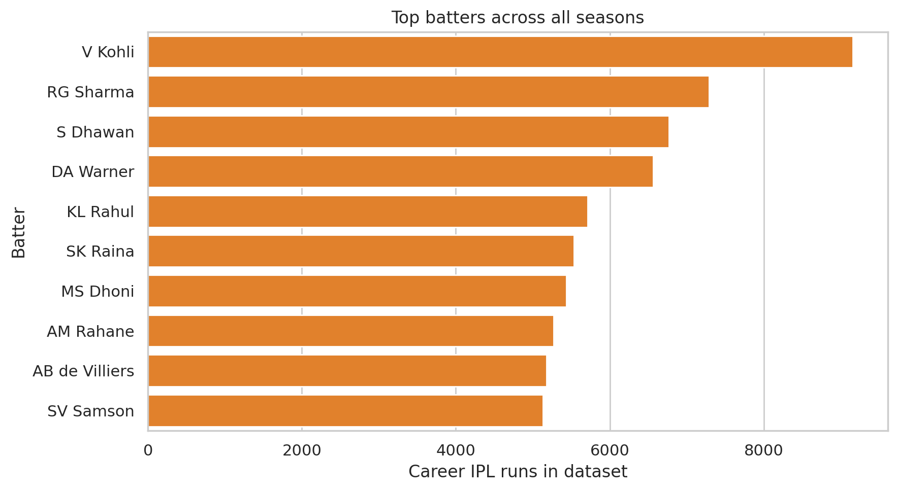

Slide 8
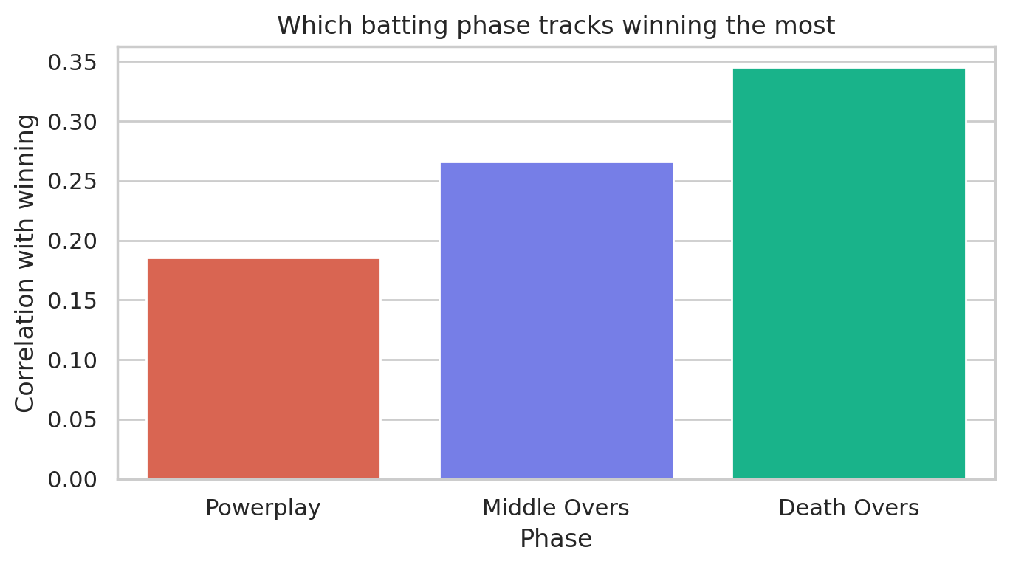

Slide 9
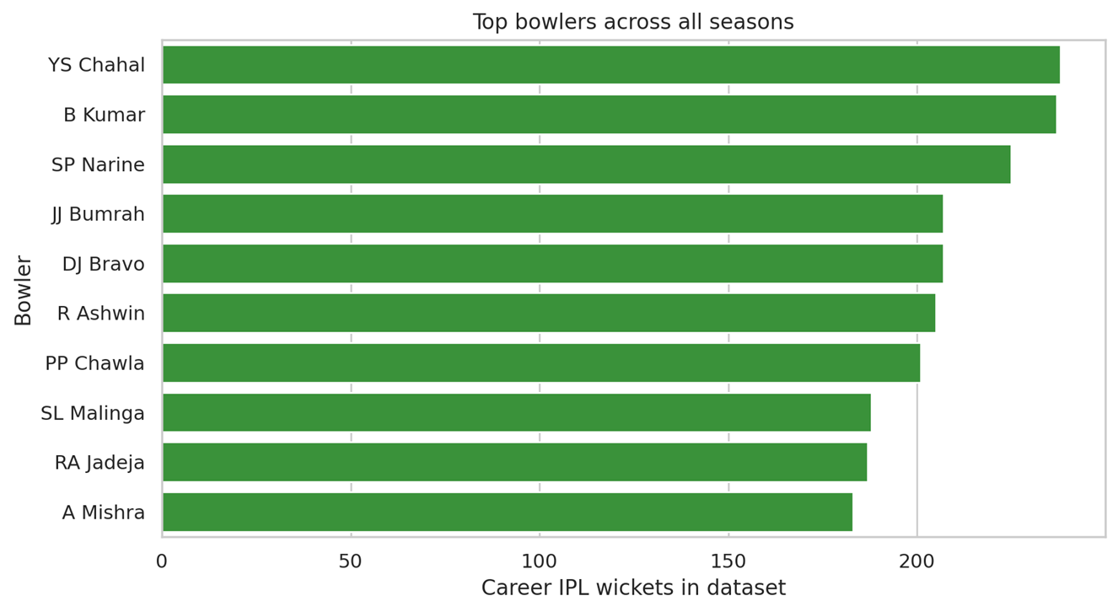

Slide 10
